Slide 1
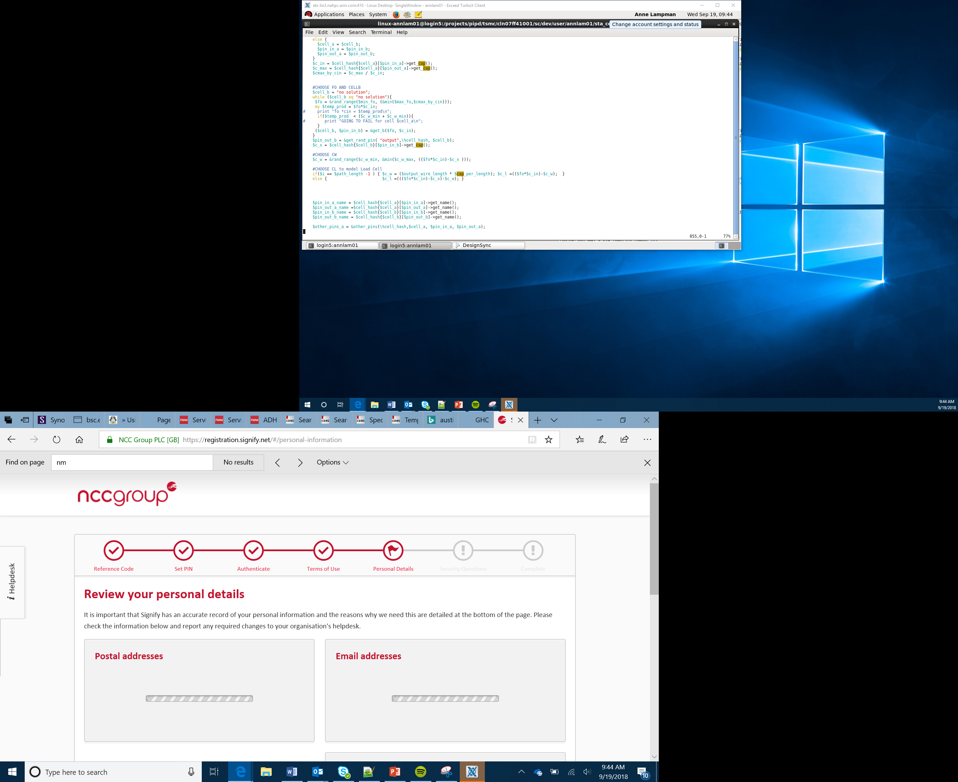

Smart Traffic Lights Activity 2
Lesson 14

Slide 2
Objectives
Apply your understanding, computational thinking and programming skills to achieve a goal
Design and create a smart traffic light system that will communicate with human and robot drivers
Use radio to send traffic signals to the self-driving car
Design and develop additional features that will be useful for drivers, pedestrians and city authorities
Notes:
Share objectives – remind Learners of the project aims

Slide 3
Smart Traffic Lights
Smart traffic lights are already in use:
Carnegie Mellon University is piloting smart traffic lights to reduce vehicle emissions in Pittsburgh. The traffic light timings are changed dynamically by communicating with the different lights in the city and adapting for changing driving conditions in order to reduce or avoid congestion
In the UK, traffic lights that monitor vehicle speed and change to red when cars are travelling too fast are already in place – this helps reduce accidents by encourage drivers to slow down to avoid red traffic lights
Notes:
Discuss current use of smart traffic lights in different countries
Consider how traffic lights will need to change with self-driving and normal cars on the roads together

Slide 4
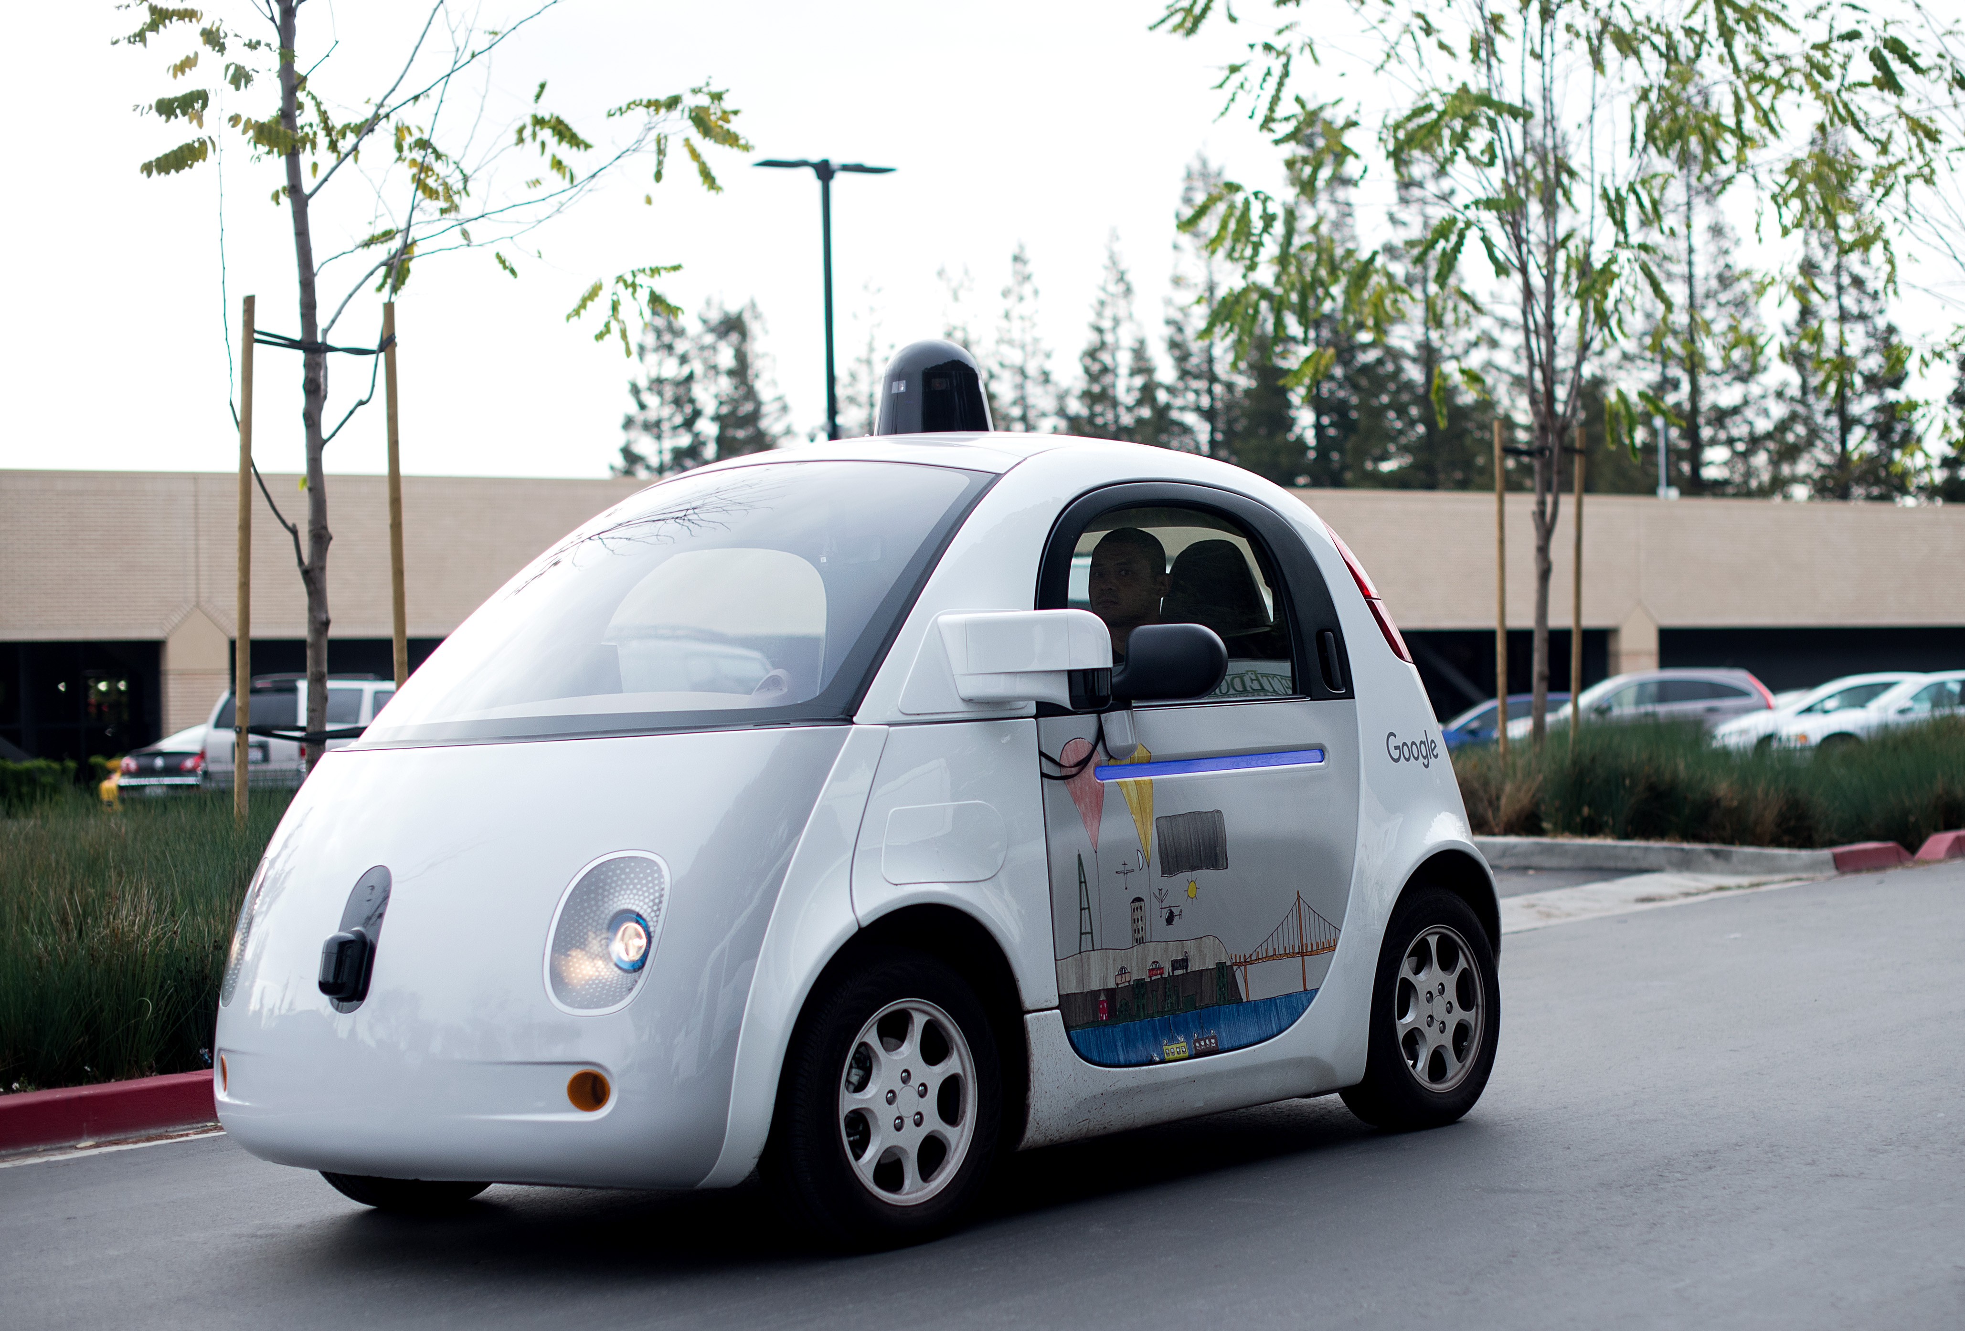
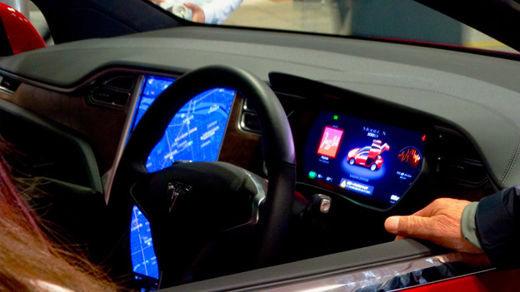
Autonomy
The future rise in autonomous and self-driving cars means that we will have to consider how we apply traffic rules so they can be ‘seen’ and obeyed by human drivers as well as self-driving vehicles

Slide 5
Radio
We have already looked at how we can use Radio to communicate between to computer devices
By applying this technology to traffic lights we could command self-driving cars to stop on red lights while a human driver stops on seeing the red signal
Notes:
Remind Learners of how we used radio, get them to look back at this lesson and the review how it worked
It is also a good time to look at the other sensors and discuss how these could also be used within traffic lights for self-driving vehicles

Slide 6
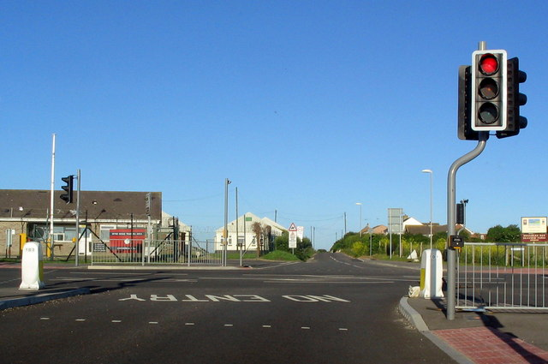
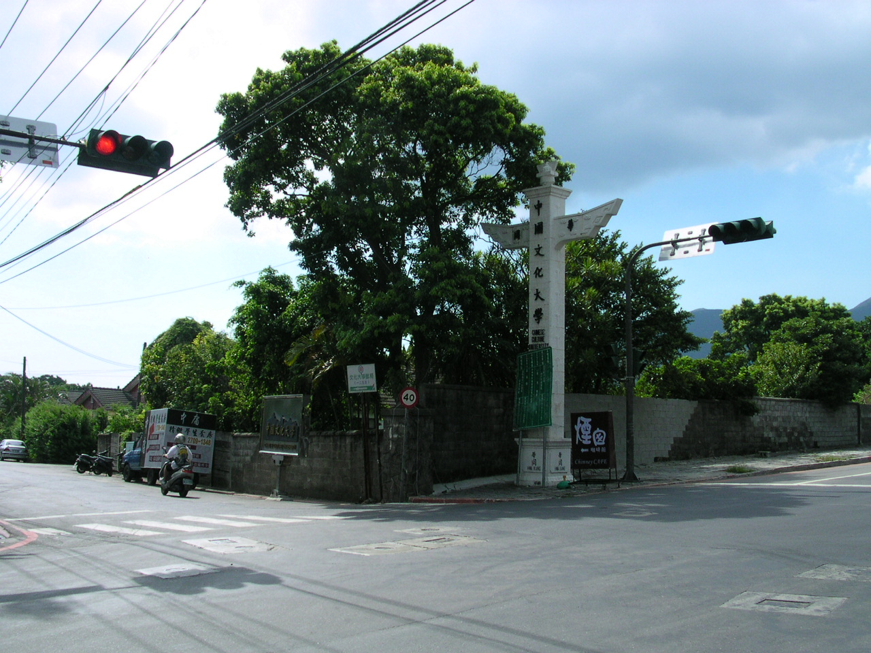
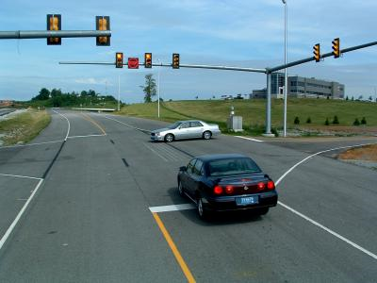
Traffic Lights
What is the sequence of a set of traffic lights?
Are each light on for the same amount of time?
Consider how we could use NeoPixels or standard LEDs to create the different colours
Notes:
Ensure Learners are aware of different types of traffic lights, and how lights differ in other countries – will this need standardising for self-driving cars?
Ensure Learners know the sequence of a set of lights. In the UK this is RED, RED & AMBER, GREEN, AMBER
Discuss why the lights are not always on for the same amount of time – why?

Slide 7
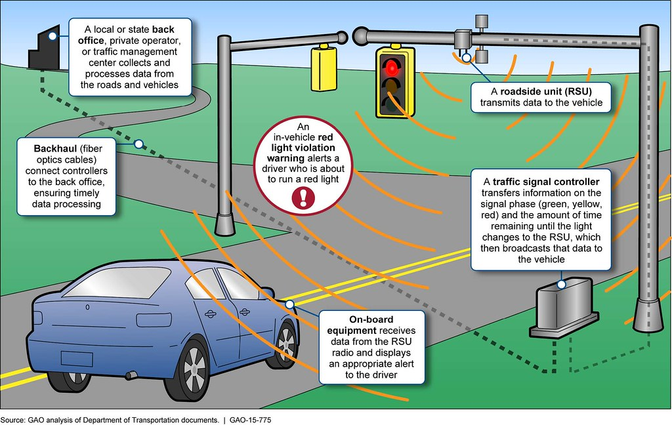

Slide 8

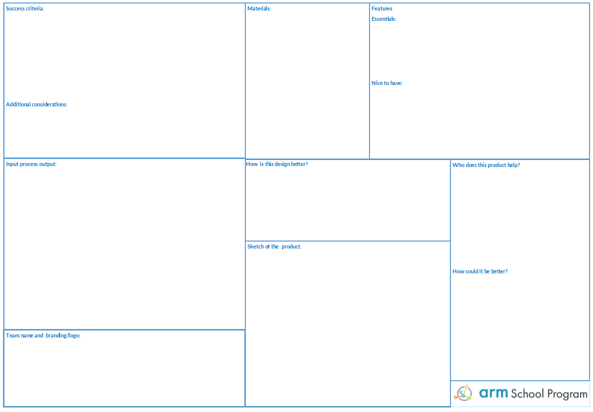
Re-visiting the design
Update your design worksheet from last lesson to include the new autonomous and smart features required
Complete an IPO table for the smart lights

Slide 9
Smart Traffic Lights PBL
Success Criteria
Apply your understanding computational thinking and programming skills to achieve a goal
Design and create a smart traffic light system that will communicate with human and robot drivers
Use radio to send traffic signals to the self-driving car
Try incorporating a line sensor to ensure the car stops are the right place if the traffic light is on stop or could the ultrasonic sensor be employed here also?
Design and develop additional features that will be useful for drivers, pedestrians and city authorities
Notes:
Introduce the task
Support Learners in their use of radio and sensors

